Slide 1
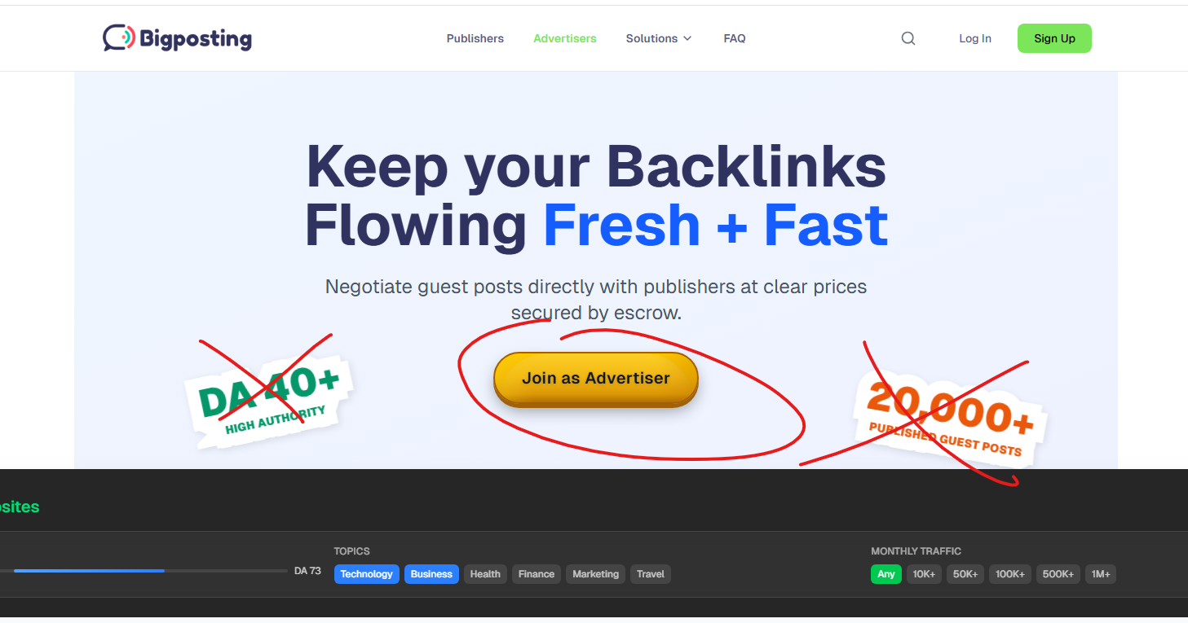
The color of the button is old fashioned, make it flat, different color
Overall, use the colors from our Bigposting logo
Remove the fake statistics
The button should say “Register for free”

Slide 2
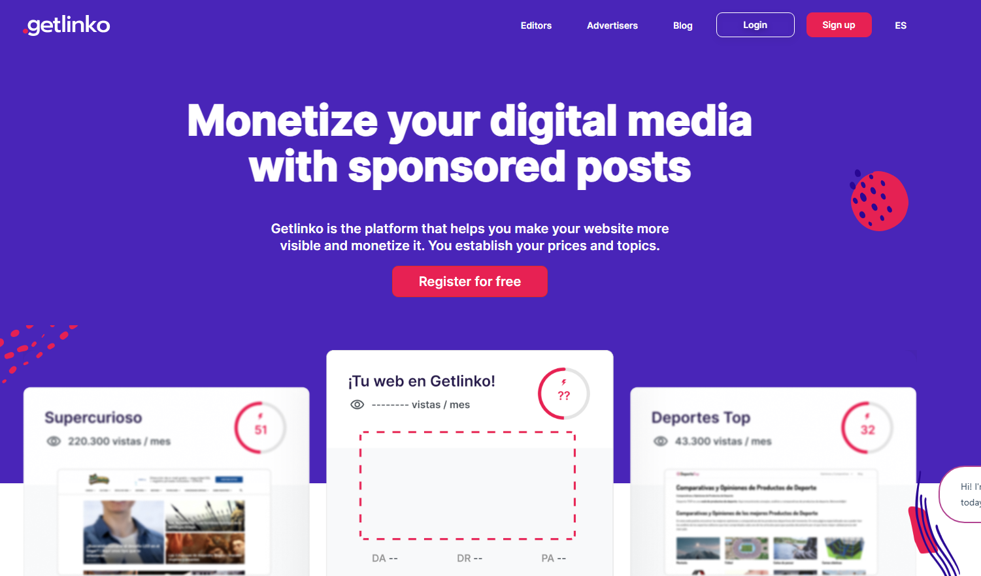
Get inspired by https://getlinko.com/en/3-editors/
Nice and clean: 3 images with features from the system

Slide 3
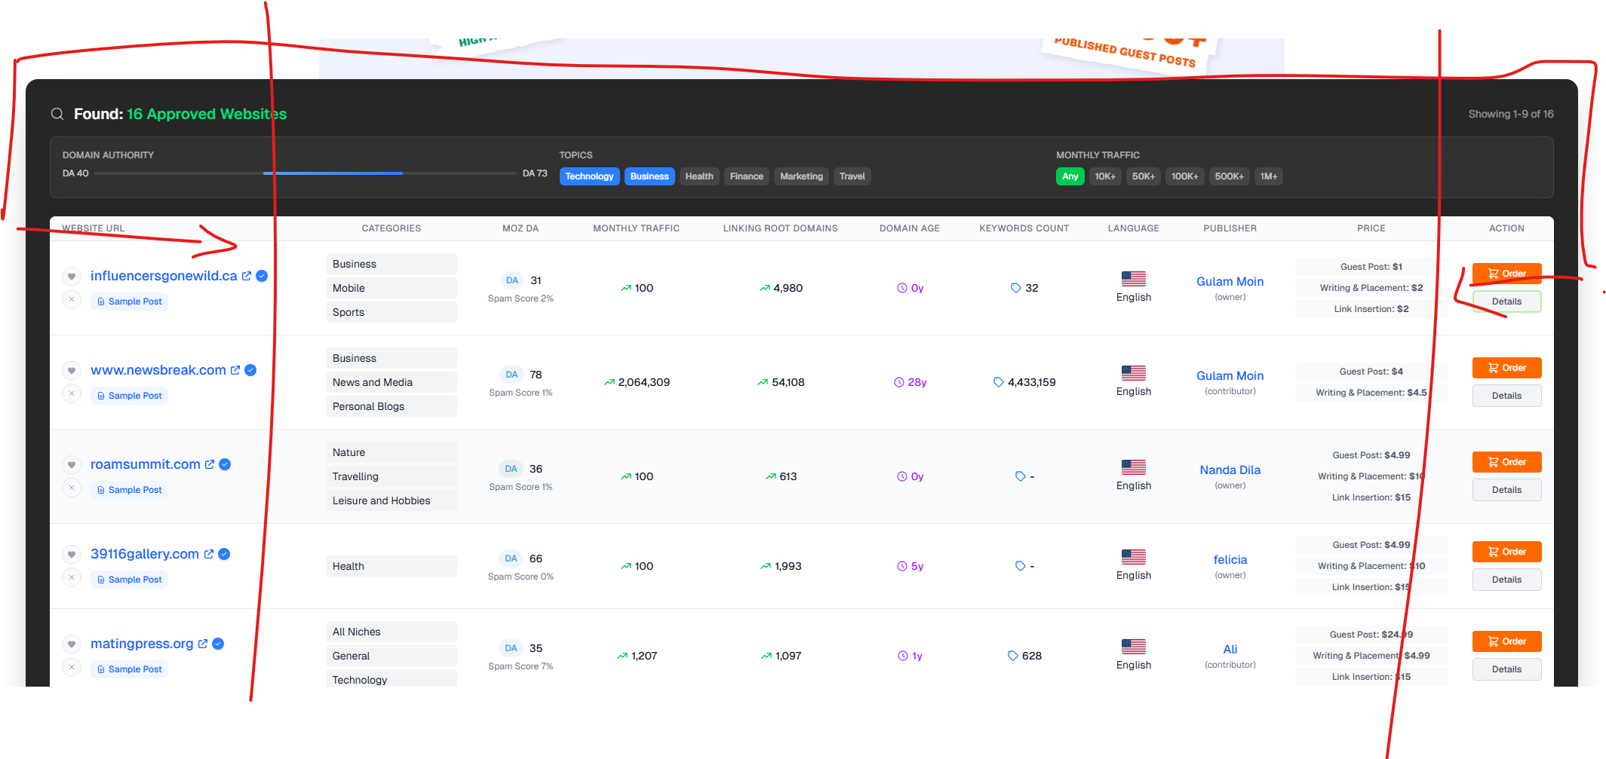
Make this section not so wide, leave more space on the sides. Now it is too massive, it should fit one screen and be smaller

Slide 4
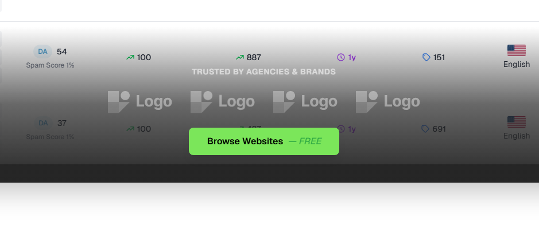
Replace 4x logo with AI generated logos in black/white – not real companies
Remove “free” from the button and keep only “Browse websites”

Slide 5
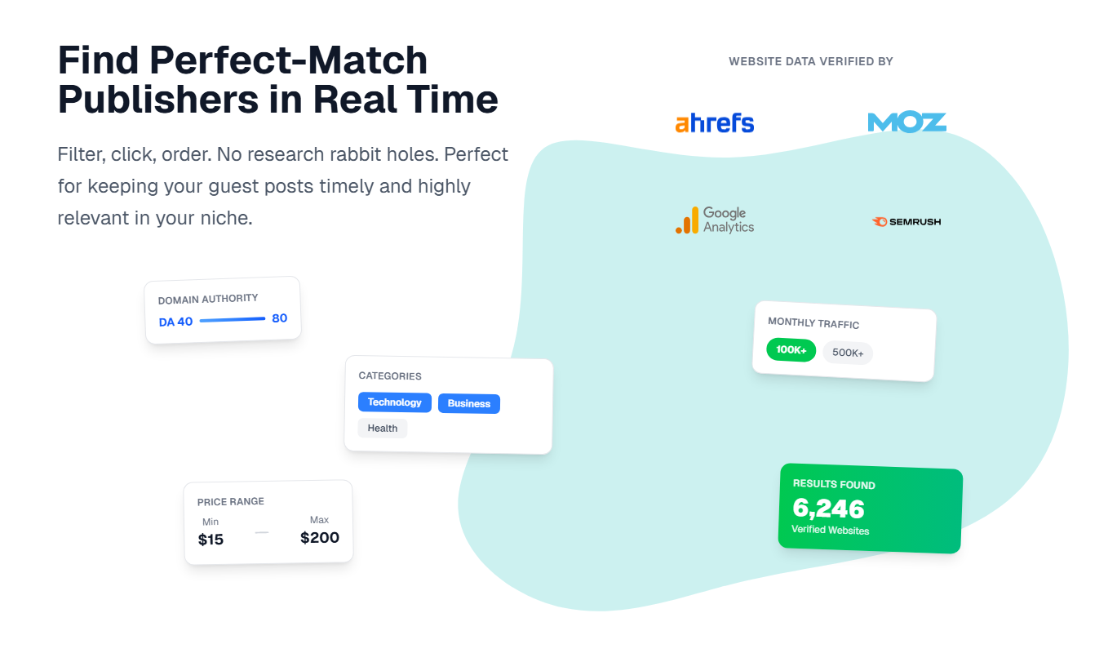
This section is cool and does not need changes

Slide 6
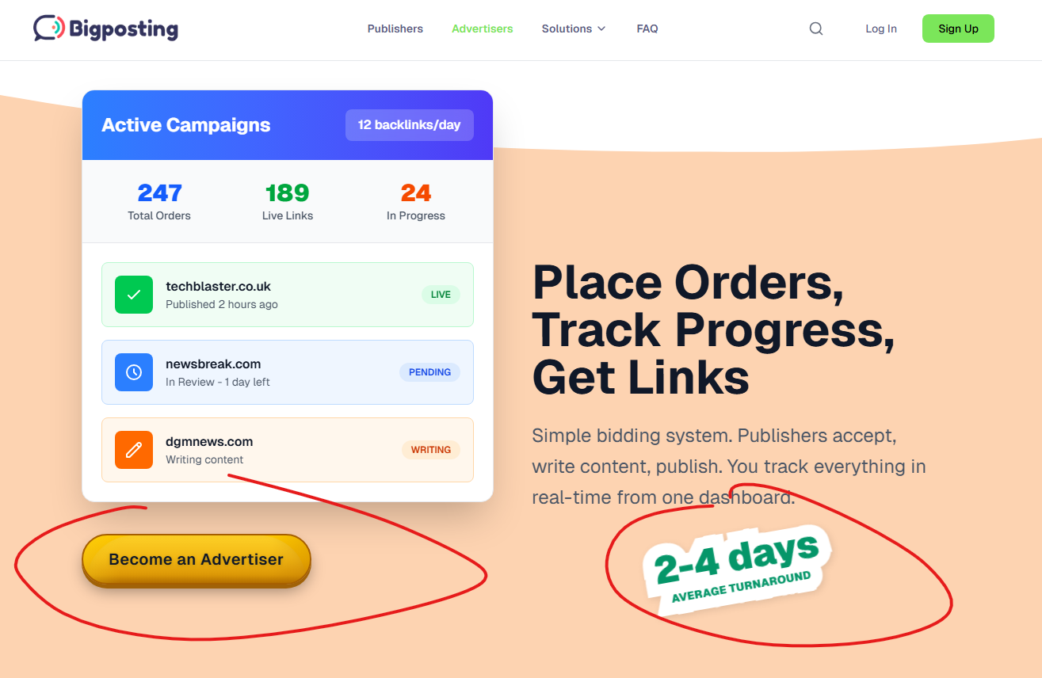
Replace 2-4 days with “fast turnaround”, get your links fast
Again, change the ugly “amazon” button with something modern
Lighter color of the background
Stick to colors from our logo

Slide 7
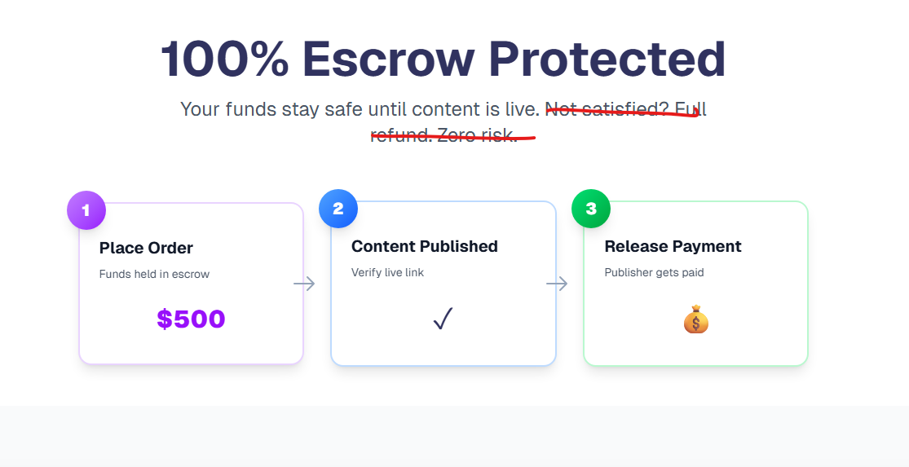
Change text to:
100% Escrow Protected
Your funds are securely held until the content is reviewed and approved by you. Payments are only released once the publication is verified on the target site.

Slide 8
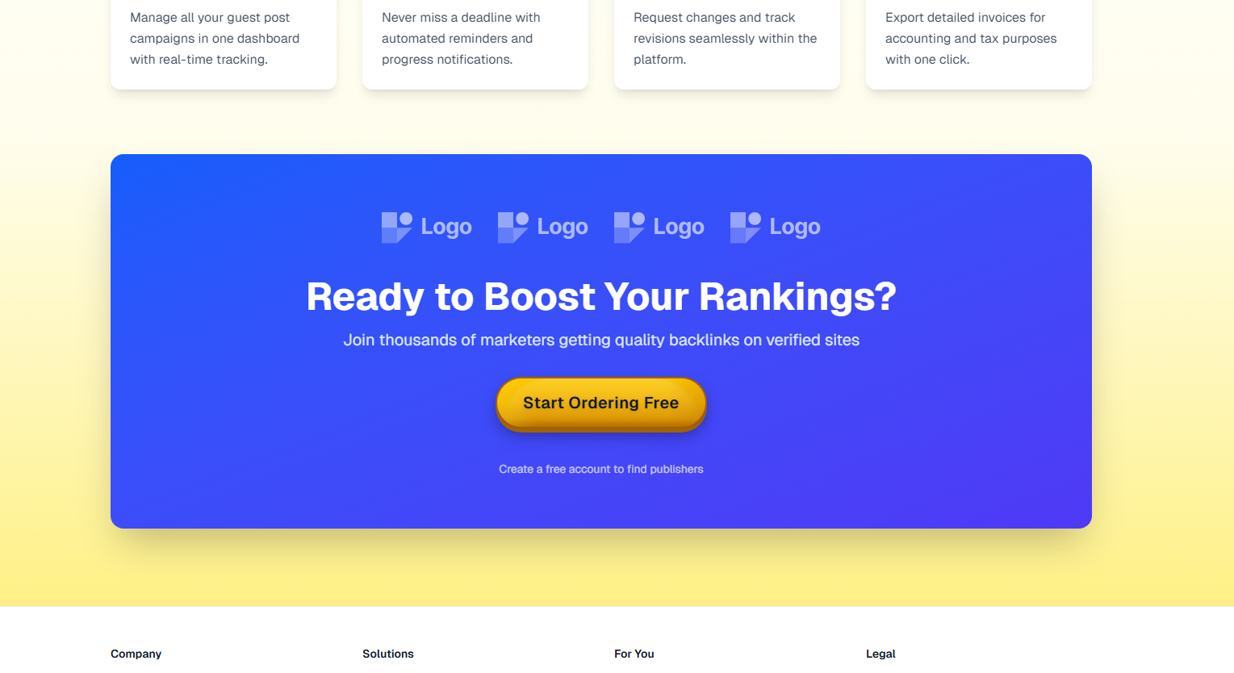
Button grammar error: it should be “start ordering now” – the service is not for free.
Logos need to be replaced with something else. The color combination of yellow and blue is terrible
Stick to colors from the logo if you don’t know what colors to use

Slide 9
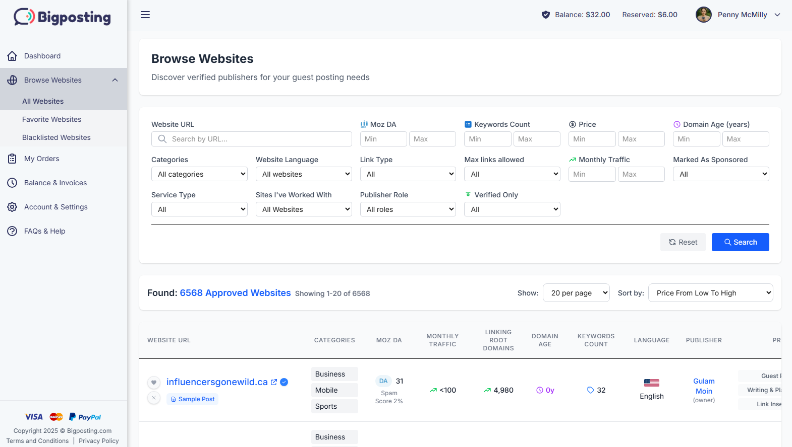
Why not using a screenshot somewhere with the system mockup to show them what to expect?
This could appear on a laptop screen

Slide 10
Why not using a screenshot somewhere with the system mockup to show them what to expect?
This could appear on a laptop screen

Slide 11
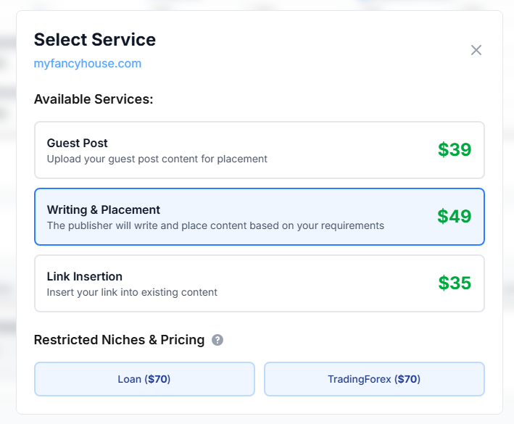
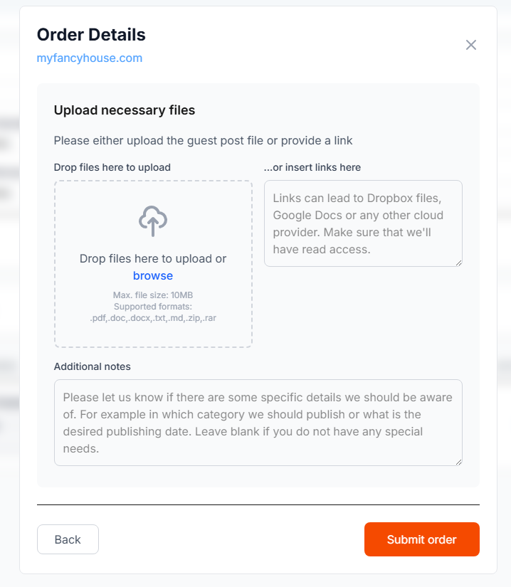
Why not using a screenshot somewhere with the system mockup to show them what to expect? You can show the ordering form – two steps to show how it works

Slide 12
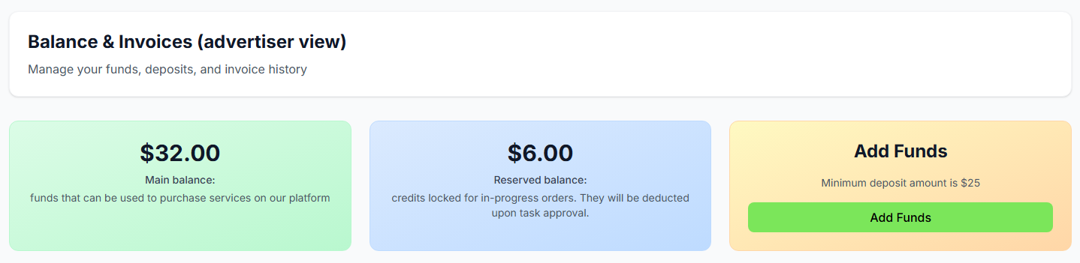
We can also display this screen: how advertisers can expect
How the balance overview looks like
This will give an overview before registration

Slide 13
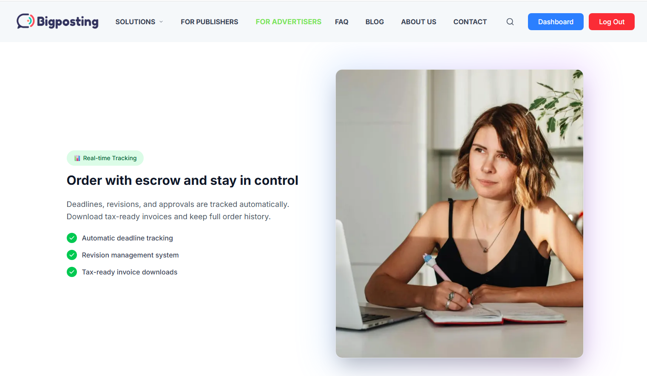
At least 1x somewhere use a picture of a real person (advertiser) to increase trust by showing real picture of real person with laptop (preferably white woman), use stock image or generate via AI.

